Slide 1

Machine Learning and Data Mining
Lecture 1.2: Statistical Learning – MLE / MAP

Slide 2
HW1 Out!
HW1 is out now. Due in 2 weeks. Has two parts:
Implement k Nearest Neighbors and K-Fold Cross Validation and reason about our dataset/preprocessing (80% of the points)
Some math to fit parameters to a Poisson-Gamma model. We will cover the principles involved today with different distributions. (20% of the points)
Involves submission to a class Kaggle competition for the test set. Bonus points for beating the TA entry. Bragging rights for being in the top 5.

Slide 4




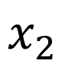
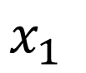
Intuition for your First Machine Learning Algorithm
$$x_{1}$$
$$x_{2}$$

Slide 5
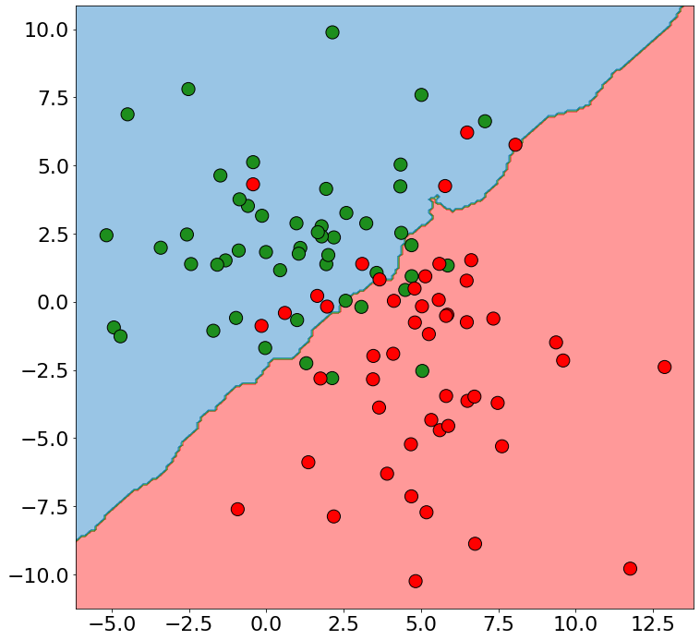
More on the Effect of k on Decision Boundaries
k=20
If your dataset has noise or many examples, these decision boundaries can become nasty!
Noisy training examples might lead to poor generalization to new data.
We can try to combat this by increasing the number of neighbors we examine.

Slide 6
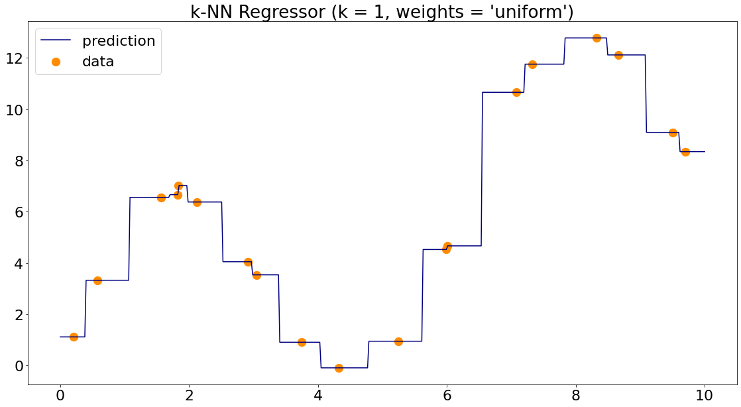
Formalizing k-Nearest Neighbors for Regression

Slide 7
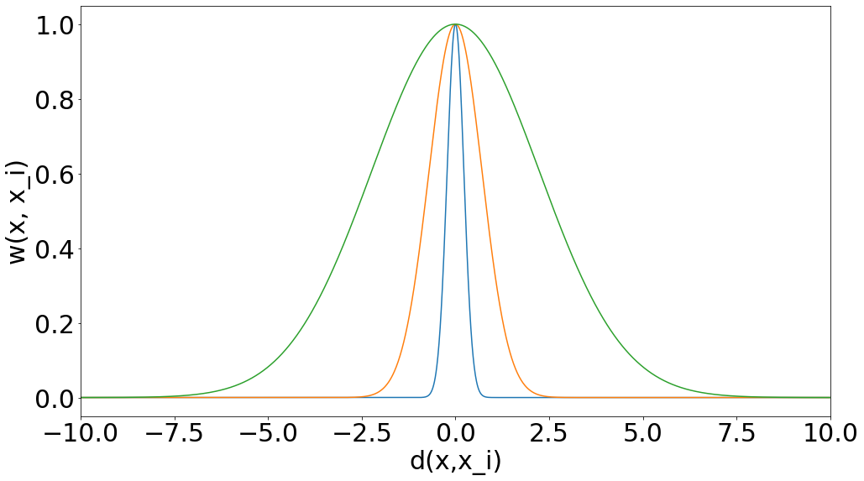
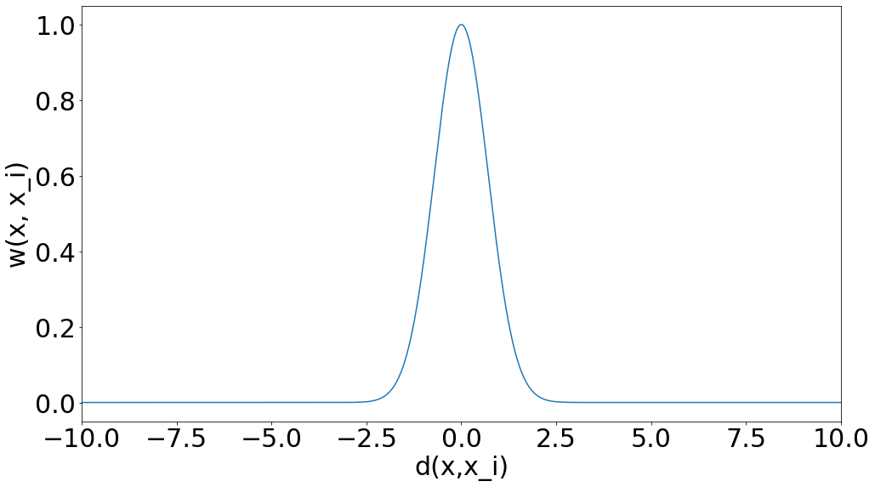

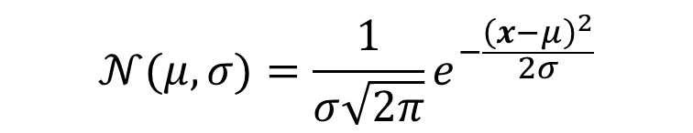
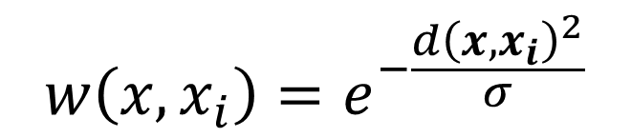
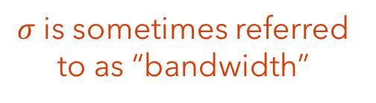
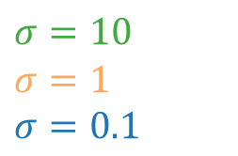
Weighted k-Nearest Neighbor
What makes a good weight function?
Gets small as distance from point gets large
One good candidate:
$$σ=10$$
$$σ=1$$
$$σ=0.1$$
$$w\left(x,x_{i}\right)=e^{−\frac{d{\left(x,x_{i}\right)}^{2}}{σ}}$$
$σ$is sometimes referred to as “bandwidth”
$$𝒩(μ, σ)=\frac{1}{σ\sqrt{2π}}e^{−\frac{{\left(x−μ\right)}^{2}}{2σ}}$$
Does these curves look familiar?
Gaussians my dear Watson. Gaussians!

Slide 8
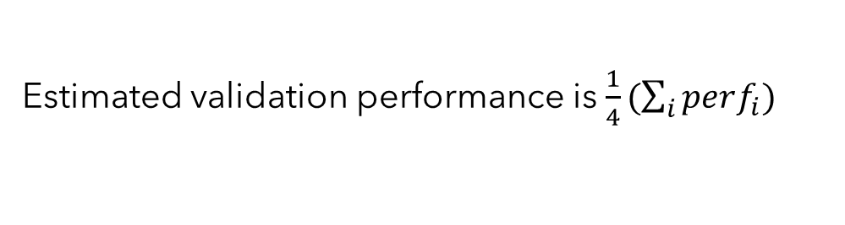
Model Selection – K-fold Cross Validation
Idea: Make many validation sets and evaluate model choices by average performance over them.
Training Data
Subset 1
Subset 2
Subset 3
Subset 4
Train on subsets 2,3,4. Test on subset 1 → $perf_{1}$
Subset 1
Subset 2
Subset 3
Subset 4
Train on subsets 1,3,4. Test on subset 2 → $perf_{2}$
Subset 1
Subset 2
Subset 3
Subset 4
Train on subsets 1,2,4. Test on subset 3 → $perf_{3}$
Subset 1
Subset 2
Subset 3
Subset 4
Train on subsets 1,2,3. Test on subset 4 → $perf_{4}$
Example: 4-fold cross validation
Estimated validation performance is $\frac{1}{4}(\sum_{i}{perf_{i})}$

Slide 9
Be able to answer:
What are basic concepts and definitions in probability theory?
What is maximum likelihood estimation (MLE)?
What is a likelihood function?
What is the MLE estimate for a Bernoulli variable?
What is bias and variance of an estimator?
What is the MLE estimate for a Normal variable?
What is a maximum a posteriori estimate (MAP)?
What is a prior and posterior? What is a conjugate?
What is the MAP estimate for a Bernoulli-Beta model?

Slide 10

Why do we care about probability?
The world is a very uncertain place
30 years of Artificial Intelligence research danced around this fact
Then some AI researchers decided to use some ideas from the eighteenth century to model uncertainty…
For us: Really useful view of machine learning (both in practice for algorithm design and for deriving theoretic results about learning)
ML
Machine
Learning
Machine
Learning
Machine
Learning
Machine
Learning
Statistics
Slide adapted from Dhruv Batra. Comic a modification from 2016 webcomic Shen Comix.

Slide 11



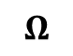
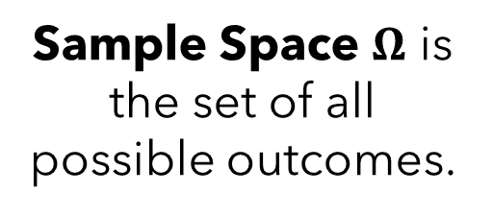
Brief Probability Review
Humans are sort of trash at probability. Doubly so once equations get involved.
Easiest to imagine a set of worlds where every possible outcome occurs.
Example: Consider the probability of me having various careers.
$$Ω$$
Sample Space $Ω$ is the set of all possible outcomes.

Slide 12
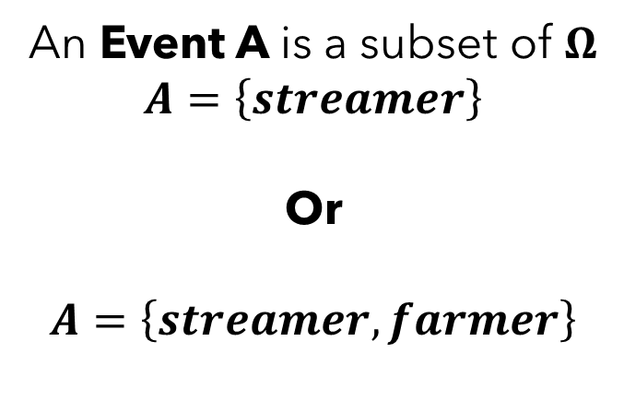
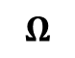
Brief Probability Review
Sample Space $Ω$ is the set of all possible outcomes.
$$Ω$$
An Event A is a subset of $Ω$ $$A=\left\{streamer\right\}$$
Or
$$A=\left\{streamer, farmer\right\}$$
Think of this as an or

Slide 13
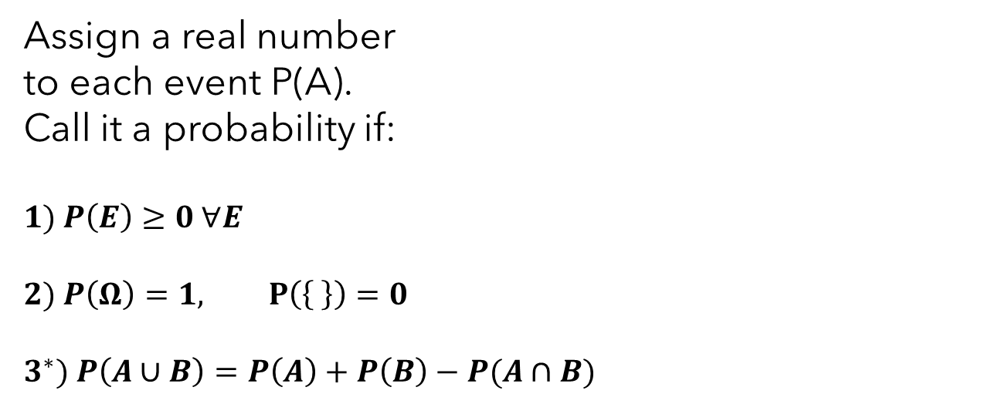
Brief Probability Review
Sample Space $Ω$ is the set of all possible outcomes.
An Event A is a subset of $Ω$, e.g. A={streamer} or {streamer, farmer}
$$Ω$$
Assign a real number to each event P(A). Call it a probability if:
$$1) P\left(E\right)≥0 ∀E$$
$$2) P\left(Ω\right)=1, P\left(\left\{ \right\}\right)=0$$
$$3^{∗}) P\left(A∪B\right)=P\left(A\right)+P\left(B\right)−P(A∩B)$$
*This is not the $σ$-addivity axiom typically cited as the 3rd axiom but is roughly equivalent. Good enough for us.

Slide 14
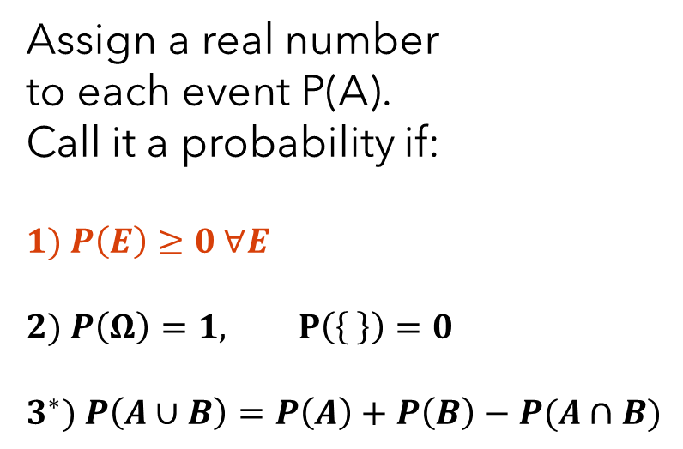
Brief Probability Review
Sample Space $Ω$ is the set of all possible outcomes.
An Event A is a subset of $Ω$, e.g. A={streamer} or {streamer, farmer}
$$Ω$$
Assign a real number to each event P(A). Call it a probability if:
$$1) P\left(E\right)≥0 ∀E$$
$$2) P\left(Ω\right)=1, P\left(\left\{ \right\}\right)=0$$
$$3^{∗}) P\left(A∪B\right)=P\left(A\right)+P\left(B\right)−P(A∩B)$$
Worlds where E is true

Slide 15
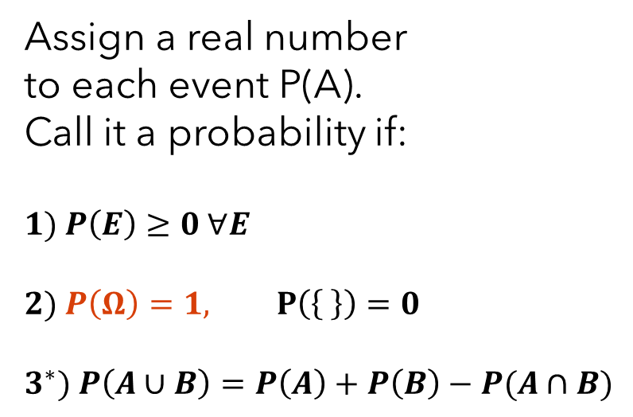
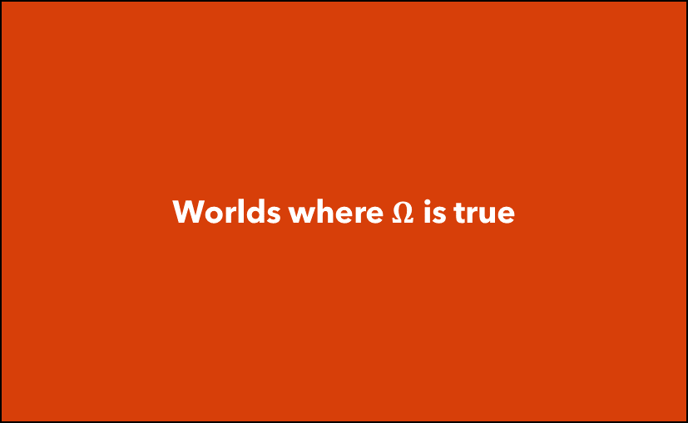
Brief Probability Review
Sample Space $Ω$ is the set of all possible outcomes.
An Event A is a subset of $Ω$, e.g. A={streamer} or {streamer, farmer}
$$Ω$$
Assign a real number to each event P(A). Call it a probability if:
$$1) P\left(E\right)≥0 ∀E$$
$$2) P\left(Ω\right)=1, P\left(\left\{ \right\}\right)=0$$
$$3^{∗}) P\left(A∪B\right)=P\left(A\right)+P\left(B\right)−P(A∩B)$$
Worlds where $Ω$ is true
Worlds where any event occurs

Slide 16
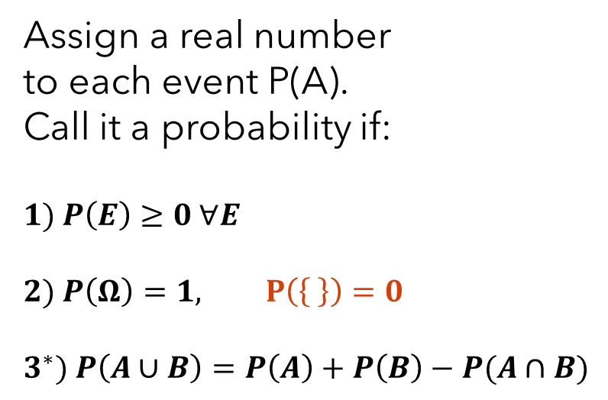
Brief Probability Review
Sample Space $Ω$ is the set of all possible outcomes.
An Event A is a subset of $Ω$, e.g. A={streamer} or {streamer, farmer}
$$Ω$$
Assign a real number to each event P(A). Call it a probability if:
$$1) P\left(E\right)≥0 ∀E$$
$$2) P\left(Ω\right)=1, P\left(\left\{ \right\}\right)=0$$
$$3^{∗}) P\left(A∪B\right)=P\left(A\right)+P\left(B\right)−P(A∩B)$$
Worlds where none of the possible events occur?

Slide 17
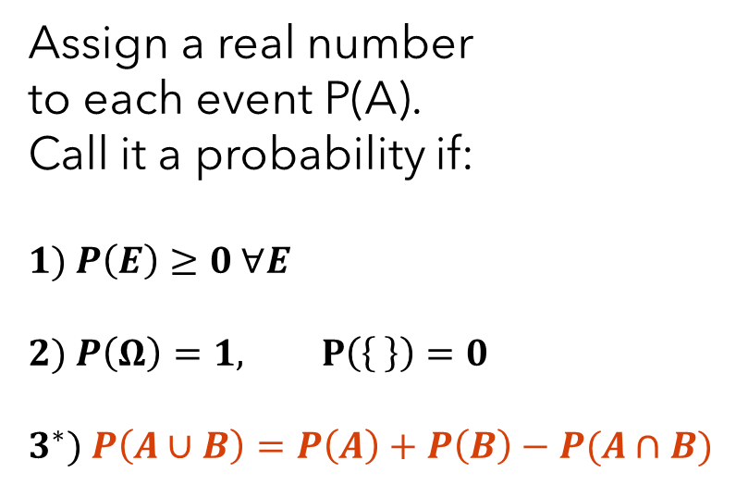
Brief Probability Review
Sample Space $Ω$ is the set of all possible outcomes.
An Event A is a subset of $Ω$, e.g. A={streamer} or {streamer, farmer}
$$Ω$$
Assign a real number to each event P(A). Call it a probability if:
$$1) P\left(E\right)≥0 ∀E$$
$$2) P\left(Ω\right)=1, P\left(\left\{ \right\}\right)=0$$
$$3^{∗}) P\left(A∪B\right)=P\left(A\right)+P\left(B\right)−P(A∩B)$$
Worlds where A is true
Worlds where B is true
Don’t want to double count the area of intersection!

Slide 18
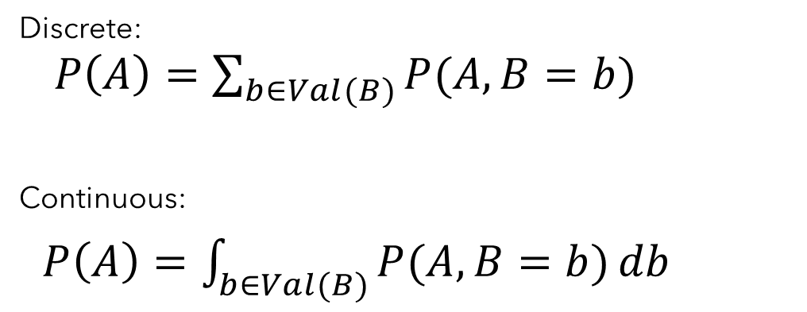
Brief Probability Review
Marginalization: Can “sum out” events from joint distributions
Worlds where A is true
Discrete:
$P\left(A\right)=\sum_{b∈Val(B)}{P(A, B=b)}$
Continuous:
$P\left(A\right)=\int_{b∈Val(B)}{P(A, B=b)}db$
Worlds where B is not true
Worlds where B is true
$$P\left(A\right)=P\left(A, B=False\right)+P(A, B=True)$$

Slide 19
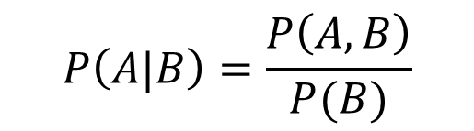
Brief Probability Review
Conditional Distributions: P(A|B) – Of worlds where B occurs, what fraction also have A?
Worlds where A is true
$$P\left(A|B\right)=\frac{P\left(A,B\right)}{P(B)}$$
Worlds where B is true
$$P\left(A,B\right)=P\left(A | B\right)P\left(B\right)=P\left(B | A\right)P(A)$$
Chain Rule:

Slide 20
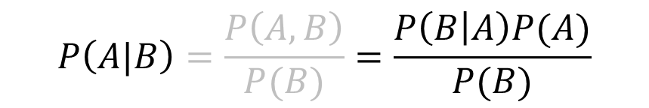
Brief Probability Review
Bayes Rule: A useful way to reverse direction of conditional distributions. Combines chain rule and definition of conditional distribution. Simple yet fundamental.
$$P\left(A|B\right)=\frac{P\left(A,B\right)}{P(B)}=\frac{P\left(B | A\right)P(A)}{P(B)}$$

Slide 21
Brief Probability Review
A Random Variable X is a mapping between events in $Ω$ to numbers.
X(A)
0 | 1 | 2 | 3 | 4
Streamer | Professor | Telemarketer | Programmer | …
Event A
Coin flip example. What does the random variable Y represent?
Y(B)
2 | 1 | 2 | 0 | …
H,H,T | T,T,H | H,T,H | T,T,T | …
Event B

Slide 22
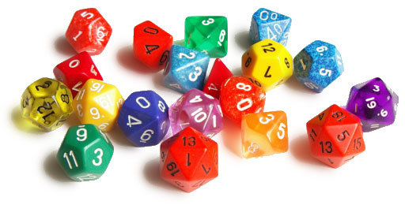
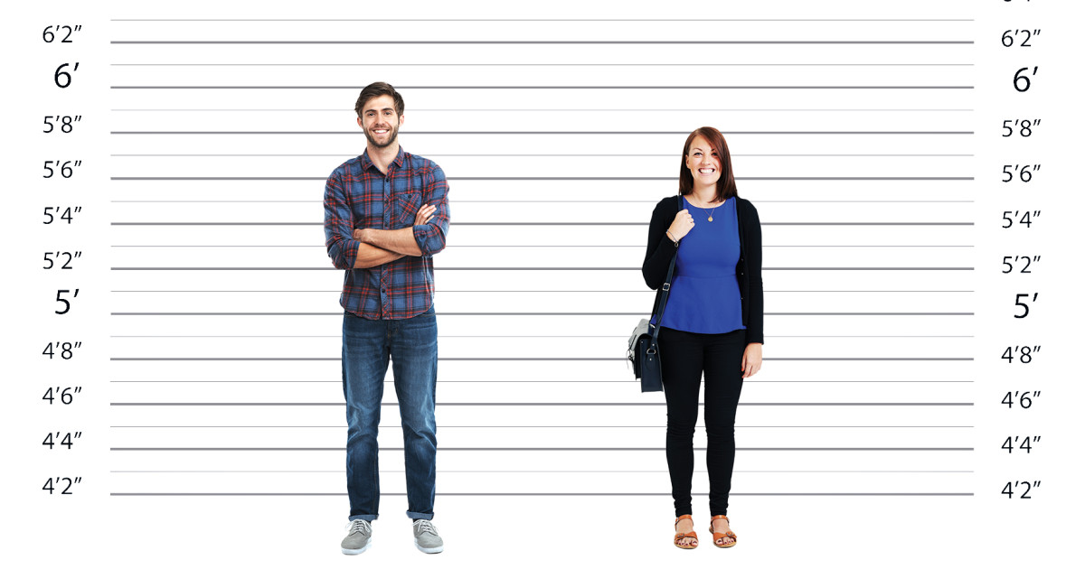
Brief Probability Review
A Random Variable X is a mapping between events in $Ω$ to numbers.
Discrete random variables take on one of a finite set of values
Can reason about the probability of specific values
Continuous random variables take on one of an infinite set of values (e.g. height)
Probability of any specific value is pretty much zero
Easier to talk about probability of being in a range

Slide 23
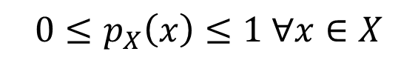
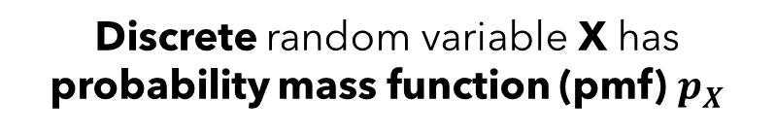
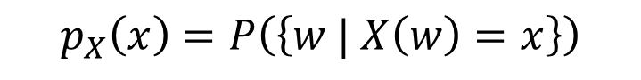
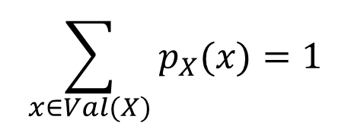
Brief Probability Review
Probability densities describe a mapping from values of X to probabilities
Discrete random variable X has probability mass function (pmf) $p_{X}$
$$p_{X}\left(x\right)=P\left(\left\{w | X\left(w\right)=x\right\}\right)$$
$$0≤p_{X}\left(x\right)≤1 ∀x∈X$$
$$\sum_{x∈Val(X)}{p_{X}(x)}=1$$

Slide 24
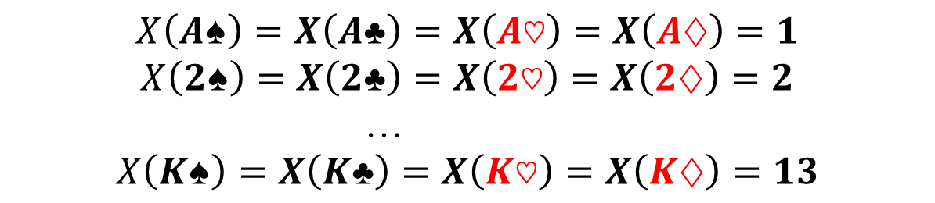

Brief Probability Review
Consider drawing a card from a standard 52 card deck:
Sample Space $Ω=\left\{A♠, A♣,A♡,A♢,2♠, 2♣,2♡,2♢, …,K♠, K♣,K♡,K♢\right\}$
Let’s define a discrete random variable X such that:
$$X\left(A♠\right)=X\left(A♣\right)=X\left(A♡\right)=X\left(A♢\right)=1$$
$$X\left(2♠\right)=X\left(2♣\right)=X\left(2♡\right)=X\left(2♢\right)=2$$
…
$$X\left(K♠\right)=X\left(K♣\right)=X\left(K♡\right)=X\left(K♢\right)=13$$
Check the probability of a specific outcome:
$$P_{X}\left(x=13\right)=P\left(\left\{w ∣ X\left(w\right)=13\right\}\right)=\frac{4}{52}$$

Slide 25
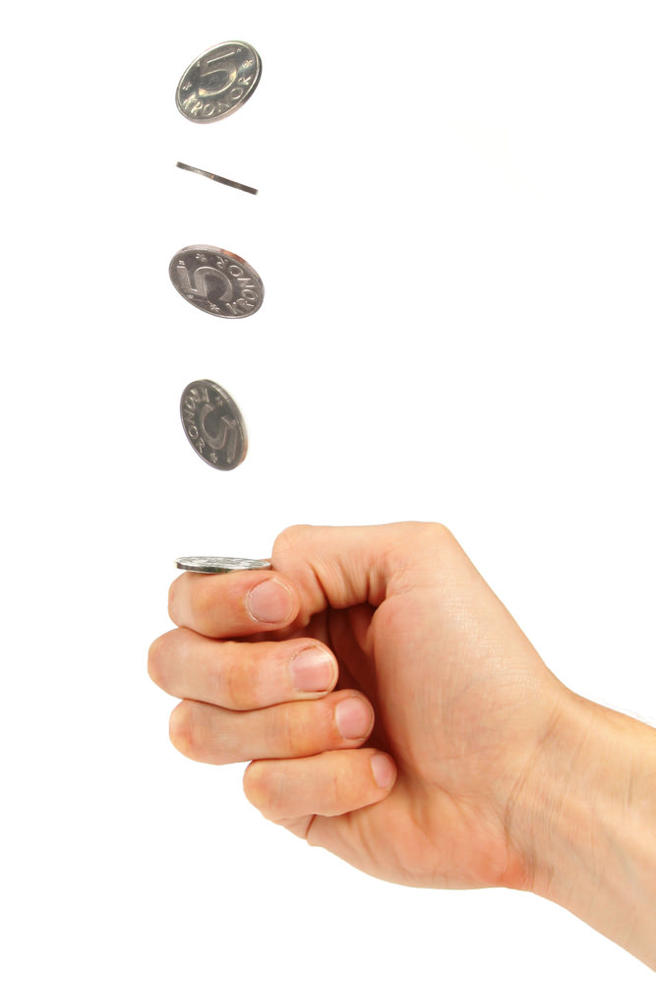
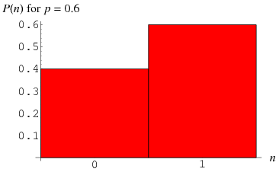
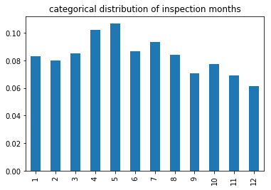
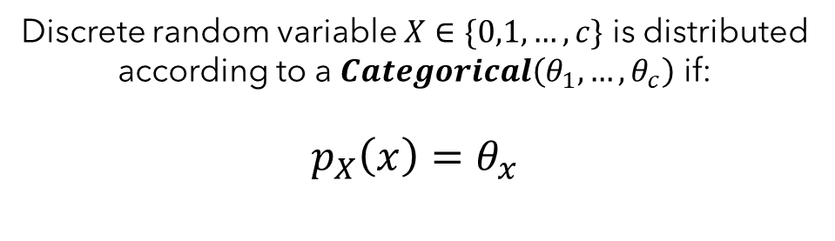
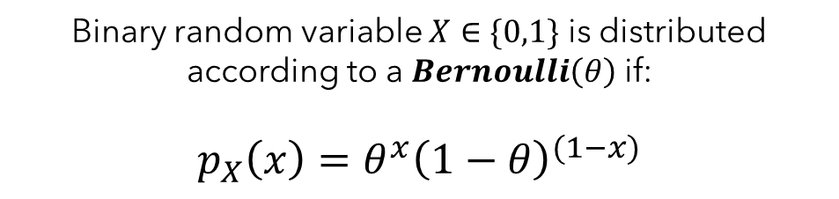
Brief Probability Review
Common discrete distributions:
Binary random variable $X∈\{0,1\}$ is distributed according to a $Bernoulli\left(θ\right)$ if:
$$p_{X}\left(x\right)=θ^{x}{\left(1−θ\right)}^{(1−x)}$$
Discrete random variable $X∈\{0,1,…,c\}$ is distributed according to a $Categorical\left(θ_{1}, …, θ_{c}\right)$ if:
$$p_{X}\left(x\right)=θ_{x}$$

Slide 26
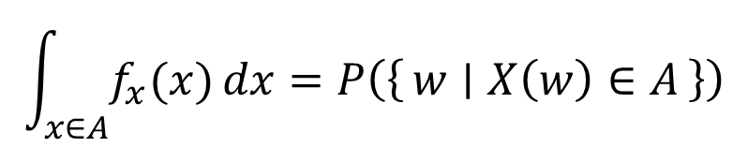
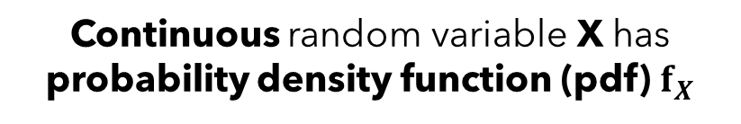

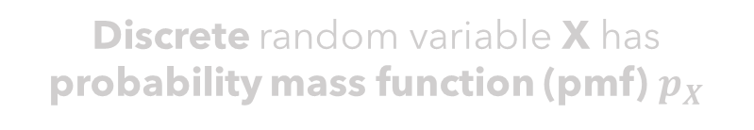

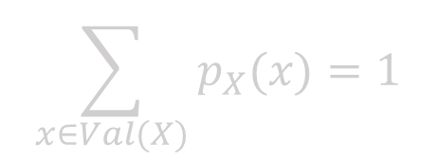
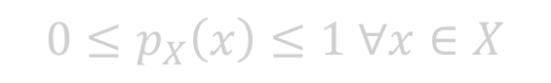

Brief Probability Review
Probability densities describe a mapping from values of X to probabilities
Discrete random variable X has probability mass function (pmf) $p_{X}$
Continuous random variable X has probability density function (pdf) $f_{X}$
$$\int_{x∈A}{f_{x}(x)}dx=P\left(\left\{w ∣ X\left(w\right)∈A\right\}\right)$$
$$p_{X}\left(x\right)=P\left(\left\{w | X\left(w\right)=x\right\}\right)$$
Note that f can be greater than 1
$$0≤p_{X}\left(x\right)≤1 ∀x∈X$$
$$f_{X}\left(x\right)≥0 ∀x∈X$$
$$\sum_{x∈Val(X)}{p_{X}(x)}=1$$
$$\int_{x∈Val(X)}{f_{x}(x)}dx=1$$

Slide 27
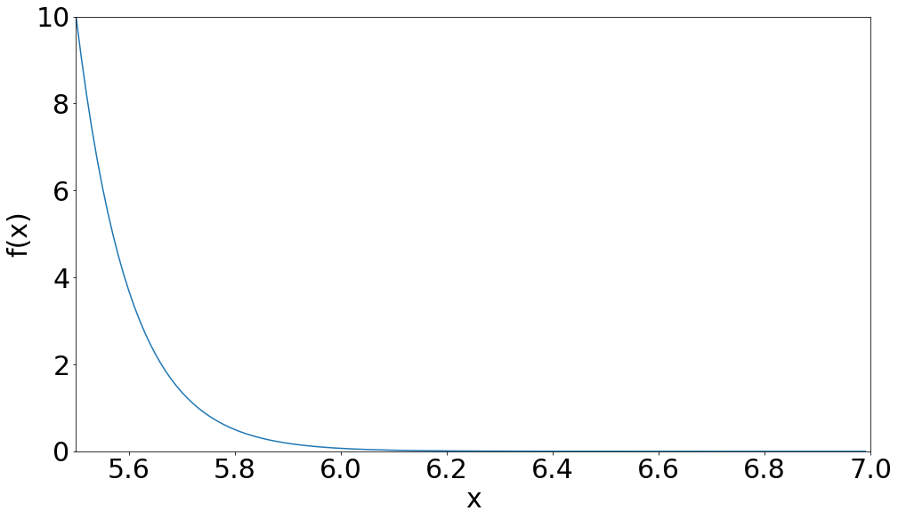
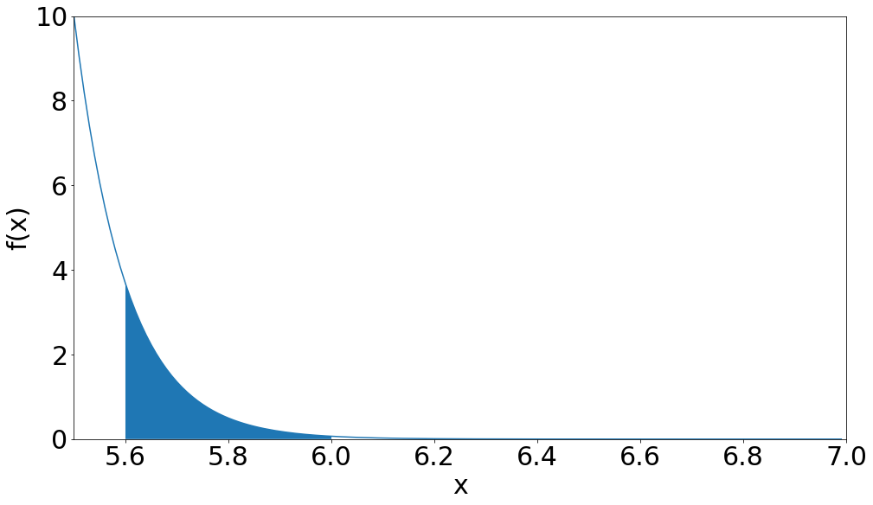
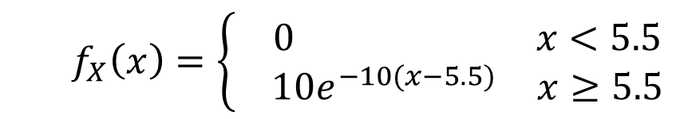
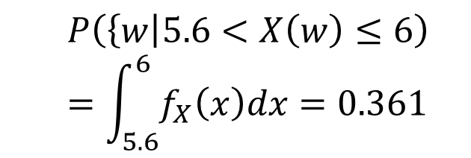
Brief Probability Review
Sample Space $Ω=(0, ∞)$ be the width of pipes from a factory in cm
$$f_{X}\left(x\right)=\left\{\begin{aligned}\begin{matrix} 0 & x<5.5\end{matrix} \\ \begin{matrix} 10e^{−10(x−5.5)} & x≥5.5\end{matrix}\end{aligned}\right.$$
$$P\left(\left\{w\right|5.6<X\left(w\right)≤6\right)$$
$$=\int_{5.6}^{6}{f_{X}\left(x\right)dx}=0.361$$

Slide 28
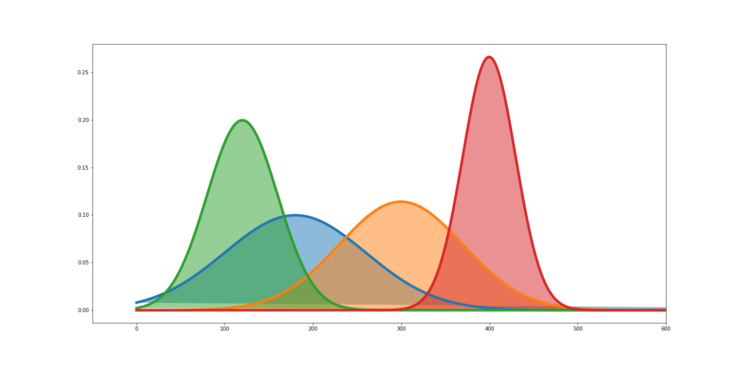
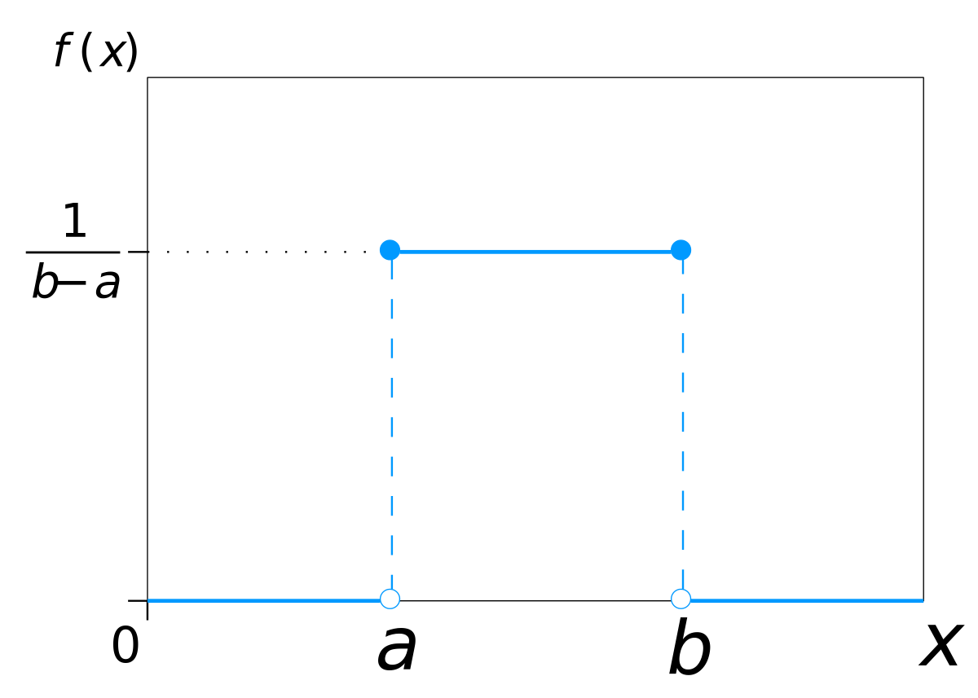
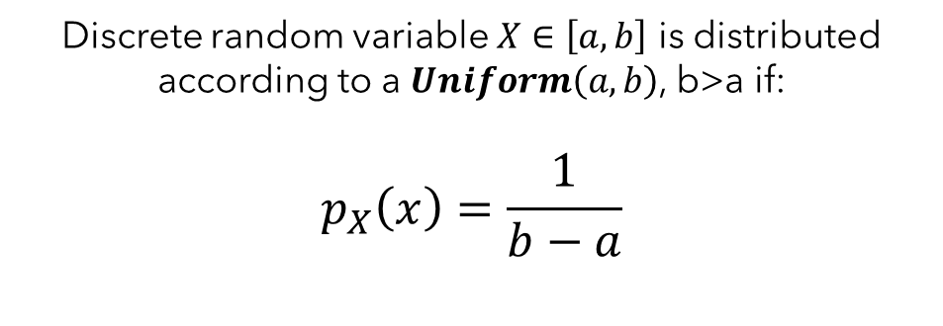
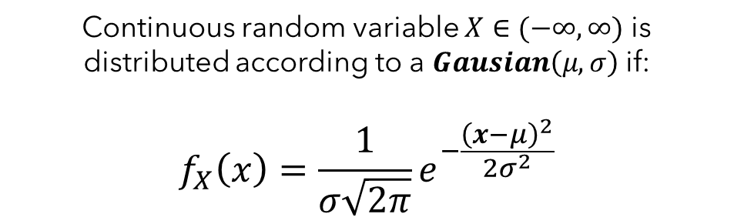
Brief Probability Review
Common continuous distributions:
Continuous random variable $X∈(−∞,∞)$ is distributed according to a $Gausian\left(μ, σ\right)$ if:
$$f_{X}\left(x\right)=\frac{1}{σ\sqrt{2π}}e^{−\frac{{\left(x−μ\right)}^{2}}{2σ^{2}}}$$
Discrete random variable $X∈\left[a,b\right]$ is distributed according to a $Uniform\left(a,b\right)$, b>a if:
$$p_{X}\left(x\right)=\frac{1}{b−a}$$

Slide 29
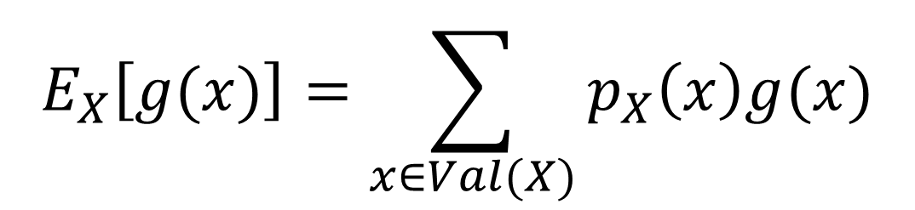


Brief Probability Review
Expectation (Discrete Random Variable X):
Value of g$(⋅)$ at x
$$E_{X}\left[g(x)\right]=\sum_{x∈Val(X)}{p_{X}\left(x\right)g(x)}$$
Probability of X=x
Can think of it as an average of $g(x)$ when $x^{′}s$ are sample from $p_{X}$
or equivalently
as a weighted average of $g(x)$ with weight $p_{X}(x)$

Slide 30



Brief Probability Review
Expectation (Continuous Random Variable X):
Value of $g(⋅)$ at x
$$E_{X}\left[g(x)\right]=\int_{x∈Val(X)}{f_{x}\left(x\right)g(x)}dx$$
Probability density of X=x
Can think of it as an average of $g(x)$ when $x^{′}s$ are sample from $f_{X}$
or equivalently
as a weighted average of $g(x)$ with weight $f_{X}(x)$

Slide 31





Brief Probability Review
Sample Space $Ω=(0, ∞)$ be the width of pipes from a factory in cm.
Suppose you have to pay a penalty of $50 for every mm over 5.7.
What is the average penalty for a pipe produced from your factory?
$$f_{X}\left(x\right)=\left\{\begin{aligned}\begin{matrix} 0 & x<5.5\end{matrix} \\ \begin{matrix} 10e^{−10(x−5.5)} & x≥5.5\end{matrix}\end{aligned}\right.$$
$$g\left(x\right)=\left\{\begin{aligned}\begin{matrix} 0 & x≤5.7\end{matrix} \\ \begin{matrix} 50(x−5.7) & x>5.7\end{matrix}\end{aligned}\right.$$
$$E_{X}\left[g(x)\right]=\int_{−∞}^{∞}{f_{X}\left(x\right)g\left(x\right)dx}≈\$0.67$$

Slide 32


Brief Probability Review
Properties of Expectation
$$E_{X}\left[aX+bY\right]=aE_{x}\left[X\right]+bE_{X}[Y]$$
$$E_{X,Y}\left[XY\right]=E_{x}\left[X\right]E_{Y}\left[Y\right] if X⫫Y$$
X and Y are independent

Slide 33
Brief Probability Review
A couple of special expectations:
$$E_{X}\left[x\right]=mean of X$$
$$Var\left[x\right]=E_{X}\left[{\left(x−E_{X}\left[x\right]\right)}^{2}\right]$$
$$=E_{X}\left[x^{2}−2XE_{X}\left[x\right]+E_{X}{\left[x\right]}^{2}\right]$$
$$=E_{X}\left[x^{2}\right]−2E_{X}\left[x\right]E_{X}\left[X\right]+E_{X}{\left[x\right]}^{2}$$
$$=E_{X}\left[x^{2}\right]−E_{X}{\left[x\right]}^{2}$$

Slide 34


Brief Probability Review
Let X be a Gaussian random variable with mean 0 and variance 1:
$Var\left[x\right]=E\left[x^{2}\right]−E{\left[x\right]}^{2}$ but mean is zero so $Var\left[x\right]=E\left[x^{2}\right]$ and the variance is given as 1
$$E_{X}\left[ax^{2}+bx+c\right]=aE_{X}\left[x^{2}\right]+bE_{X}\left[x\right]+c$$
$E_{X}\left[x\right]$ is the mean = 0

Slide 35


A Philosophic Debate: Interpreting Probabilities
What does it mean when we say P(A)?
Frequentist View:
Normalized limiting frequency of a repeating, non-deterministic event
If I keep sampling worlds, then P(A) is $\lim_{N→∞}{\frac{\#(A is true)}{N}}$
Makes sense for things I can repeat, like coin flips. But what about things like P(“earth explodes on January 1, 2000”) that only happen once?
Bayesian View:
P(A) is your “belief” about A
Slide adapted from Dhruv Batra.

Slide 36


A Probabilistic View of Supervised Machine Learning
View our data as random variables:
X (input) and Y (output) are random variables and the dataset is drawn from their joint distribution: $x_{i}, y_{i}∼P(X,Y)$
Datasets are formed by repeatedly sampling from $P(X,Y)$
IID: Independently and Identically Distributed
Assume training and testing are drawn IID from $P(X,Y)$
Implies some hope of performing well on test
Imagine if that weren’t the case? The test set would be systematically different than the training set… bad news.

Slide 37
Be able to answer:
What are basic concepts and definitions in probability theory?
What is maximum likelihood estimation (MLE)?
What is a likelihood function?
What is the MLE estimate for a Bernoulli variable?
What is bias and variance of an estimator?
What is the MLE estimate for a Normal variable?
What is a maximum a posteriori estimate (MAP)?
What is a prior and posterior? What is a conjugate?
What is the MAP estimate for a Bernoulli-Beta model?

Slide 38
Your First Probabilistic Learning Algorithm: MLE
We will often want to “learn” parameters for our models that make our models “agree” with some observed data as much as possible.
Probability gives us a nice tool for reasoning about this – namely, that we would want to find parameters such that the observed data has high probability under our models.
We will start with very simple models today but will be reusing these techniques a few times throughout the course.

Slide 39


Your First Probabilistic Learning Algorithm: MLE
After taking this course, you drop out of OSU and join an illegal betting company focused on underground mascot fights because you want to start making some real money with ML.
Your new boss asks you:
If Benny Beaver and the Oregon Duck face off, what is the probability Benny wins?
Knowing that data is everything, you ask:
What happened in the past? W, W, L, L, W
VS
You say P(Benny Wins) = ?
Why?
This slide in no way condones or encourages underground mascot fights or illegal gambling. Even if we would win.

Slide 40

Your First Probabilistic Learning Algorithm: MLE
The intuitive answer is that 3/5 “fits the data” the best. We’ll formalize that notion this lecture.
Maximum Likelihood Estimation – Find parameters that make the observed data most likely.
Assume a probabilistic model of how the data was generated $x∼P(x;θ)$ parameterized by some set of parameters $θ$
Find ${\hat{θ}}_{MLE}$ that maximizes the probability (or likelihood) of generating the training data under the probabilistic model.
Why MLE?
Often leads to “natural” or intuitive parameter estimates
MLE is optimal if model class is correct (e.g. Normal model for normally distributed data)

Slide 41












Our “generative story” for mascot fights
Assume: Benny has some constant probability of winning any given fight – call this theta.
$P\left(win\right)=θ.$ Let’s say $θ=0.7.$ How does this number relate to the outcomes we observe?
$$rand\left(0,1\right)≤0.7$$
$$rand\left(0,1\right)≤0.7$$
$$rand\left(0,1\right)≤0.7$$
$$rand\left(0,1\right)≤0.7$$
$$0.8≤0.7⇒False$$
$$0.4≤0.7⇒True$$
$$0.9≤0.7⇒False$$
$$0.29≤0.7⇒True$$
VS
VS
VS
VS
$$x_{1}=0$$
$$x_{2}=1$$
$$x_{3}=0$$
$$x_{4}=1$$
This slide in no way condones or encourages underground mascot fights or illegal gambling. Even if we would win.

Slide 42
Maximum Likelihood Estimation (MLE)
MLE answers the question: What value of theta makes the data we observed MOST likely?
$$P\left(win\right)=θ$$
$P\left(W,W,L,L,W \right|θ=0.1)$ would be small
$P\left(W,W,L,L,W \right|θ=0.99)$ would be very small
VS
VS
VS
VS
VS
This slide in no way condones or encourages underground mascot fights or illegal gambling. Even if we would win.

Slide 43






Baby Steps: Estimating the Weight of a Coin with MLE
Dataset: Suppose you observe a coin flipped 6 times such that $D=\{H, T, H, H, H,T\}$
Model Assumption: Assume the probability of getting heads on the coin is some unknown $θ$.
Write out likelihood of the training data as a function of parameters $θ$:
$$𝓛\left(θ\right)=P\left(D∣θ\right)=P\left(\left\{H,T,H,H,H,T\right\}|θ\right)$$
$$=P\left(H|θ\right)P\left(T|θ\right)P\left(H|θ\right)P\left(H|θ\right)P\left(H|θ\right)P(T|θ)$$
$$=θ(1−θ)θθθ(1−θ)$$
$$=θ^{4}{\left(1−θ\right)}^{2}$$
Find ${\hat{θ}}_{MLE}=\underset{θ}{argmax} 𝓛\left(θ\right)$:
Any guesses what the peak of the graph is?
$$θ^{4}{\left(1−θ\right)}^{2}$$
$$\frac{4}{6}=\frac{\#Heads}{\#Heads+\#Tails}$$
Is this generally true?

Slide 44



What assumption did we make when we set $P\left(\left\{H,T,H,H,H,T\right\}|θ\right)=P\left(H|θ\right)P\left(T|θ\right)P\left(H|θ\right)P\left(H|θ\right)P\left(H|θ\right)P(T|θ)$?
$θ$ was greater than 0.
$θ$ was greater than 0.5
Each coin flip was independent
Each coin flip was dependent

Slide 45
General Case: Estimating the Weight of a Coin with MLE
Dataset: Let $X_{i}$ be a binary random variable (H→1, T→0). Given a dataset $D={\left\{x_{i}\right\}}_{i=1}^{N}$ representing a coin being flipped N times. (e.g. {H,T,H,H,H,T} → {1,0,1,1,1,0})
Model Assumption: Assume that X is distributed according to a Bernoulli distribution with parameter $θ$ such that: $P\left(x\right)=θ^{x}{\left(1−θ\right)}^{1−x}$

Slide 46

General Case: Estimating the Weight of a Coin with MLE
Dataset: Let $X_{i}$ be a binary random variable (H→1, T→0). Given a dataset $D={\left\{x_{i}\right\}}_{i=1}^{N}$ representing a coin being flipped N times. (e.g. {H,T,H,H,H,T} → {1,0,1,1,1,0})
Model Assumption: Assume that X is distributed according to a Bernoulli distribution with parameter $θ$ such that: $P\left(x\right)=θ^{x}{\left(1−θ\right)}^{1−x}$
Write out likelihood of the training data as a function of parameters $θ$:
Collect all the like terms and sum their exponents
$$𝓛\left(θ\right)=P\left(D∣θ\right)=\prod_{i=1}^{N}{P\left(x_{i} ∣ θ\right)=\prod_{i=1}^{N}{θ^{x_{i}}{\left(1−θ\right)}^{1−x_{i}}}}$$
$$=θ^{{∑x}_{i}}{\left(1−θ\right)}^{∑(1−x_{i})}$$
Now our goal is to find $θ$ that maximizes this
$$=θ^{\#Heads}{\left(1−θ\right)}^{\#Tails}$$
Find ${\hat{θ}}_{MLE}=\underset{θ}{argmax} 𝓛\left(θ\right)$: How can we do this analytically?

Slide 47

Finding Maxima of Functions
Recall from Calculus: Maxima, minima, and saddle-points in a function are “critical points” where the derivative is zero. (Also have to consider end points if asked to find a maxima within a finite range)
Global Maxima
Local Maxima
Saddle Point
Local Minima
Can tell minima/maxima/saddles apart with 2nd derivative test to check for local concavity.

Slide 48
General Case: Estimating the Weight of a Coin with MLE
If ${\hat{θ}}_{MLE}= \underset{θ}{argmax}{ {𝓛\left(θ\right)=θ}^{\#H}{\left(1−θ\right)}^{\#T}}$, then $𝓛′({\hat{θ}}_{MLE})=0$
Taking $\frac{d}{dθ} θ^{\#H}{\left(1−θ\right)}^{\#T}$ gets messy. Lots of polynomial terms due to the exponents.
Log-likelihood is often used instead – pesky exponents get turned into scalar multipliers and products turn to sums. Recall that $\log\left(x^{a}\right)=alog\left(x\right), \log\left(ab\right)=\log\left(a\right)+\log\left(b\right), and\log\left(\frac{a}{b}\right)=\log\left(a\right)−log⁡(b)$
$$𝓛𝓛\left(θ\right)=\#H∗logθ+\#T∗log⁡(1−θ)$$
Does $\underset{θ}{argmax}{𝓛𝓛\left(θ\right)=}\underset{θ}{argmax}{𝓛\left(θ\right)}$? Yes! Log is monotonically increasing so argmax are preserved.

Slide 49




General Case: Estimating the Weight of a Coin with MLE
If ${\hat{θ}}_{MLE}= \underset{θ}{argmax}{ 𝓛𝓛\left(θ\right)=\#H∗logθ+\#T∗log⁡(1−θ)}$, then $𝓛𝓛′({\hat{θ}}_{MLE})=0$
$$\frac{d}{dθ}\#H∗logθ+\#T∗\log\left(1−θ\right)=\frac{\#H}{θ}−\frac{\#T}{1−θ}$$
$$\frac{\#H}{θ}−\frac{\#T}{1−θ}=0$$
$$\left(1−θ\right)\#H−θ\#T=0$$
$$\#H−θ(\#H+\#T)=0$$
$${\hat{θ}}_{MLE}=\frac{\#H}{\#H+\#T}$$

Slide 50
Checking in. How’d we do?
I understood what just happened
I think I understood what just happened
I might not understand what just happened
I do not understand what just happened

Slide 51
Your First Probabilistic Learning Algorithm
What happened in the past? W, W, L, L, W
You say “P(Benny Wins) = 3/5 and I can prove it!
Your boss says: What if I told you they won 300 out of 500?
You say “Still 3/5 and I can prove it!”
VS
Your boss says: Which is better? 3/5 or 300/500?
You say: Uh…. Same estimate? More the merrier?
Your boss says: Why am I paying you so much?
Two concepts: Bias of your estimate – whether your estimate is right on average. Variance of your estimate– how much variability your estimator will have.
This slide in no way condones or encourages underground mascot fights or illegal gambling. Even if we would win.

Slide 52





Bias and Variance of our MLE Estimator for Bernoulli Parameter
Dataset: Let $X_{i}$ be a binary random variable (H→1, T→0). Given a dataset $D={\left\{x_{i}\right\}}_{i=1}^{N}$
$${\hat{θ}}_{MLE}=\frac{\#H}{\#H+\#T}=\frac{1}{n}\sum_{i}{x_{i}}$$
Bias: Over all possible datasets, what would I expect my error in estimating the true parameters to be on average.
$$E_{D}\left[{\hat{θ}}_{MLE}−θ\right]$$
$$=E_{D}\left[{\hat{θ}}_{MLE}\right]−E_{D}\left[θ\right]$$
$$=E_{D}\left[\frac{1}{n}\sum_{i}{x_{i}}\right]−θ$$
$$=\frac{1}{n}\left[\sum_{i}{E_{X_{i}}\left[x_{i}\right]}\right]−θ$$
Linearity of expectation
Call this an unbiased estimator as bias is 0 → no systematic error
$$=\frac{1}{n}\left[\sum_{i}{θ}\right]−θ=0$$

Slide 53






Bias and Variance of our MLE Estimator for Bernoulli Parameter
Dataset: Let $X_{i}$ be a binary random variable (H→1, T→0). Given a dataset $D={\left\{x_{i}\right\}}_{i=1}^{N}$
$${\hat{θ}}_{MLE}=\frac{\#H}{\#H+\#T}=\frac{1}{n}\sum_{i}{x_{i}}$$
Variance: Over all possible datasets, how do I expect my estimate to vary from its mean
$${Var}_{D}\left[{\hat{θ}}_{MLE}\right]=Var_{D}\left[\frac{1}{n}\sum_{i}{x_{i}}\right]$$
$$=\frac{1}{n^{2}}Var_{D}\left[\sum_{i}{x_{i}}\right]=\frac{1}{n^{2}}\sum_{i}{Var_{X_{i}}\left[x_{i}\right]}$$
$$Var\left[aX+bY\right]=a^{2}Var\left[X\right]+b^{2}Var\left[Y\right]+2abCov\left[X,Y\right]$$
Covariance is zero here as each $x_{i}$ is independent.
$Var\left[x\right]=θ\left(1−θ\right)$ for Bernoulli X
(Not shown here, you can do it)
$$=\frac{1}{n^{2}}\sum_{i}{θ\left(1−θ\right)}$$
Our estimator has lower variance as n gets larger!
$$=\frac{θ(1−θ)}{n}$$

Slide 54




For a fixed value of n, the variance still changes as a function of the theta. When does the numerator get large?
Be prepared to explain why your answer makes intuitive sense in terms of observing coin flips. E.g., why would there be higher or lower variance given the same number of observations.
$$Var\left[{\hat{θ}}_{MLE}\right]=\frac{θ(1−θ)}{n}$$
When $θ$ is close to 1
When $θ$ is close to 0
When $θ$ is close to 0.5
When n gets small

Slide 55



Numerical Simulation vs Analytic Variance
$$Var_{D}\left[{\hat{θ}}_{MLE}\right]=\frac{θ(1−θ)}{n}$$

Slide 56

Numerical Simulation vs Analytic Variance
$$Var_{D}\left[{\hat{θ}}_{MLE}\right]=\frac{θ(1−θ)}{n}$$

Slide 57

Numerical Simulation vs Analytic Variance
$$Var_{D}\left[{\hat{θ}}_{MLE}\right]=\frac{θ(1−θ)}{n}$$

Slide 58
Your First Probabilistic Learning Algorithm
What happened in the past? W, W, L, L, W
Your boss says: Which is better? 3/5 or 300/500?
You say: Uh…. Same estimate? More the merrier?
You say: Same estimate but we can be much more sure it isn’t just random variation. And of course I can prove it!
VS
Your boss says: This is why I pay you the big bucks.
This slide in no way condones or encourages underground mascot fights or illegal gambling. Even if we would win.

Slide 59

Your First Probabilistic Learning Algorithm: MLE
What is MLE for?
Fitting the parameters of probabilistic models. You assume some “generative story” of how your data was produced and then find parameters that maximize the likelihood of observed data.
Maximum Likelihood Estimation – Find parameters that make the observed data most likely.
Assume a probabilistic model of how the data was generated $x∼P(x;θ)$ parameterized by some set of parameters $θ$
Find ${\hat{θ}}_{MLE}$ that maximizes the probability (or likelihood) of generating the training data under the probabilistic model.
So far, we’ve seen MLE for Bernoulli random variables… let’s try Normal ones

Slide 60




General Case: Estimating the Mean and Variance of Normal Distribution
Dataset: Let $X_{i}$ be a continuous random variable. Given a dataset $D={\left\{x_{i}\right\}}_{i=1}^{N}$ representing some repeated independent measurement.
Model Assumption: Assume that X is distributed according to a Normal distribution with parameter $θ=(μ, σ)$ distributed according to a $𝒩\left(μ, σ\right).$
$$f_{X}\left(x\right)=\frac{1}{σ\sqrt{2π}}e^{−\frac{{\left(x−μ\right)}^{2}}{2σ^{2}}}$$
$$Normal(μ, σ)$$
Write out log-likelihood of parameters $θ$ and then find its maximum:
$$P\left(D∣θ\right)=\prod_{i=1}^{N}{P\left(x_{i} ∣ θ\right)=}\prod_{i=1}^{N}{\frac{1}{σ\sqrt{2π}}e^{−\frac{{\left(x_{i}−μ\right)}^{2}}{2σ^{2}}}}$$
$$logP\left(D∣θ\right)=Nlog\left(1\right) −\operatorname{Nlog}\left(σ\sqrt{2π}\right)−\frac{1}{2σ^{2}}\sum_{i}^{N}{{\left(x_{i}−μ\right)}^{2}}$$

Slide 61




General Case: Estimating the Mean and Variance of Normal Distribution
Write out log-likelihood of parameters $θ$ and then find its maximum:
$$logP\left(D∣θ\right)=Nlog\left(1\right) −\operatorname{Nlog}\left(σ\sqrt{2π}\right)−\frac{1}{2σ^{2}}\sum_{i}^{N}{{\left(x_{i}−μ\right)}^{2}}$$
Just the sample mean
Take derivative of parameters and find where they equal 0:
$$\frac{d logP\left(D∣θ\right)}{dμ}=\frac{1}{σ^{2}}\sum_{i}^{N}{(x_{i}−μ)}=\frac{1}{σ^{2}}\left(Nμ−\sum_{i=1}^{N}{x_{i}}\right) →μ=\frac{1}{N}\sum_{i=1}^{N}{x_{i}}$$
$$\frac{d logP\left(D∣θ\right)}{dσ}=\frac{N}{σ}−\frac{1}{σ^{3}}\sum_{i}^{N}{{\left(x_{i}−μ\right)}^{2}}=0$$
Just the sample standard deviation
$$=Nσ^{2}−\sum_{i}^{N}{{\left(x_{i}−μ\right)}^{2}}→σ=\sqrt{\frac{1}{N}\sum_{i}^{N}{{\left(x_{i}−μ\right)}^{2}}}$$

Slide 62
Be able to answer:
What are basic concepts and definitions in probability theory?
What is maximum likelihood estimation (MLE)?
What is a likelihood function?
What is the MLE estimate for a Bernoulli variable?
What is bias and variance of an estimator?
What is the MLE estimate for a Normal variable?
What is a maximum a posteriori estimate (MAP)?
What is a prior and posterior? What is a conjugate?
What is the MAP estimate for a Bernoulli-Beta model?

Slide 63
Your First Probabilistic Learning Algorithm
What happened in the past? W, W, L, L, W
Your boss says: Which is better? 3/5 or 300/500?
You say: Uh…. Same estimate? More the merrier?
You say: Same estimate but we can be much more sure it isn’t just random variation. And of course I can prove it!
VS
Your boss says: This is why I pay you the big bucks.
Your boss says: What if I’m pretty sure the duck is using performance enhancing drugs this time?
You say: Ah… Bayesian it is then...
This slide in no way condones or encourages underground mascot fights or illegal gambling. Even if we would win.

Slide 64



An Informal Way to Add Prior Belief
Assume: We believe the duck may be using performance enhancing drugs for next fight. How can we reason about this belief alongside our observations of history?
Real data we’ve observed yields
$${\hat{θ}}_{MLE}=\frac{\#wins}{total}=\frac{3}{5}$$
W
W
L
L
W
This slide in no way condones or encourages underground mascot fights or illegal gambling. Even if we would win.

Slide 65

An Informal Way to Add Prior Belief
Assume: We believe the duck may be using performance enhancing drugs for next fight. How can we reason about this belief alongside our observations of history?
Real data we’ve observed yields
$${\hat{θ}}_{MLE}=\frac{\#wins}{total}=\frac{3}{5}$$
Add fake observation to express our prior belief and find MAP:
$${\hat{θ}}_{MAP}=\frac{\#wins+\#fakewins}{total}=\frac{3}{7}$$
W
W
L
L
W
L
L
This slide in no way condones or encourages underground mascot fights or illegal gambling. Even if we would win.

Slide 66

An Informal Way to Add Prior Belief
I can express different priors and different confidences in those priors by changing the outcome/number of fake observations
Add fake observation to express our prior belief and find MAP:
$${\hat{θ}}_{MAP}=\frac{\#wins+\#fakewins}{total}=\frac{7}{13}$$
Real data we’ve observed yields
$${\hat{θ}}_{MLE}=\frac{\#wins}{total}=\frac{3}{5}$$
W
W
L
L
W
L
L
L
L
W
W
W
W
This slide in no way condones or encourages underground mascot fights or illegal gambling. Even if we would win.

Slide 67

An Informal Way to Add Prior Belief
I can express different priors and different confidences in those priors by changing the outcome/number of fake observations
Add fake observation to express our prior belief and find MAP:
$${\hat{θ}}_{MAP}=\frac{\#wins+\#fakewins}{total}=\frac{16}{18}$$
Real data we’ve observed yields
$${\hat{θ}}_{MLE}=\frac{\#wins}{total}=\frac{3}{5}$$
W
W
L
L
W
W
W
W
W
W
W
W
W
W
W
W
W
W
This slide in no way condones or encourages underground mascot fights or illegal gambling. Even if we would win.

Slide 68




A Formal Way to Add Prior Beliefs
An alternative way to reason about what we were doing is to assume some prior distribution for the value of our parameter $θ$ itself:
$$P(θ)$$
Expresses belief that theta is around 0.5, but not too certain.
$$P(θ)$$
Expresses belief that theta is near 0.9 and is fairly certain.
https://homepage.divms.uiowa.edu/~mbognar/applets/beta.html

Slide 69
Your First Probabilistic Learning Algorithm
What happened in the past? W, W, L, L, W
Your boss says: Which is better? 3/5 or 300/500?
You say: Uh…. Same estimate? More the merrier?
You say: Same estimate but we can be much more sure it isn’t just random variation. And of course I can prove it!
VS
Your boss says: This is why I pay you the big bucks.
Your boss says: What if I’m pretty sure the duck is using performance enhancing drugs this time?
You say: Ah… Bayesian it is then...
This slide in no way condones or encourages underground mascot fights or illegal gambling. Even if we would win.

Slide 70

Concepts in Bayesian Statistics
Likelihood $P(D|θ)$:
We’ve already seen this in MLE. The likelihood of the data given parameters $θ$
Priors $P(θ)$:
Express beliefs about parameters before any observations are included
Can act as regularizers (more about this next lecture)
Posterior $P\left(θ | D\right)∝P\left(D | θ\right)P(θ)$:
Distribution over $θ$ after considering both the dataset and the prior
Conjugate Priors:
Prior is conjugate to likelihood if it leads to the same distribution as posterior
Gives closed form representation of posterior!
Using non-conjugates can get computationally messy.

Slide 71

Concepts in Bayesian Statistics
We will very often be most interested in the posterior.
Likelihood
How likely theta makes the dataset
Posterior
Belief about theta after evidence and prior belief combined
$$P\left(θ | D\right)=\frac{P\left(D | θ\right)P(θ)}{P(D)}$$
Prior
Belief about theta provided by human
Constant with respect to theta so typically will not address
Important to note – the posterior is a distribution over theta!

Slide 72


Your Second Statistical Learning Algorithm: MAP
Maximum A Posteriori – Find parameters that make the observed data most likely but consider a prior over the parameters.
Assume a prior distribution over $θ, P(θ)$
Assume a probabilistic model of how the data is generated: -- parameter $θ∼P(θ)$ and then data $x∼P(x|θ)$
Find ${\hat{θ}}_{MAP}$ that maximize the posterior $P\left(θ | D\right)∝P\left(D | θ\right)P(θ)$
$$P\left(θ | D\right)=\frac{P\left(D | θ\right)P(θ)}{P(D)}$$
Why MAP?
Rigorous framework to combine observations (likelihood) with beliefs (prior)

Slide 73

Assuming a dataset D and a parameter being estimated $θ$, label these distributions:
$$P\left(θ\right), P\left(D | θ\right), P(θ|D)$$
Posterior, Prior, Likelihood
Prior, Posterior, Likelihood
Likelihood, Posterior, Prior
Prior, Likelihood, Posterior

Slide 74












A Note on Beta Distributions
$$β_{H}=1 β_{T}=1$$
$$β_{H}=5 β_{T}=5$$
Introducing the Beta Distribution
(continuous from 0 to 1)
$$P\left(θ\right)=\frac{θ^{β_{H}−1}{\left(1−θ\right)}^{β_{T}−1}}{B(β_{H}, β_{T})} =Beta(β_{H}, β_{T})$$
$$β_{H}>0 β_{T}>0$$
A normalizer so it integrates to 1.
$$β_{H}=0.01 β_{T}=0.01$$
$β_{H}=2.20 β_{T}=0.4$0
Mode of Beta = $\frac{β_{H}−1}{β_{H}+β_{T}−2}$
$$if β_{H}>1 β_{T}>1$$

Slide 75





General Case: Estimating the Bias of a Coin with MAP and a Beta Prior
Dataset: Let $X_{i}$ be a binary random variable (H→1, T→0). Given a dataset $D={\left\{x_{i}\right\}}_{i=1}^{N}$ representing a coin being flipped N times. (e.g. {H,T,H,H,H,T} → {1,0,1,1,1,0})
Model Assumption: Assume that X is distributed according to a Bernoulli distribution with parameter $θ$ distributed according to a $Beta\left(β_{H}, β_{T}\right).$
Write out posterior of parameters $θ$ and then find its maximum:
We know this term. Same as back when we did MLE.
$$P\left(θ|D\right)∝P\left(D∣θ\right)P(θ)=P(θ)\prod_{i=1}^{N}{P\left(x_{i} ∣ θ\right) }$$
$$=P\left(θ\right){ θ}^{\#H}{\left(1−θ\right)}^{\#T}$$
$$P\left(θ\right)=\frac{θ^{β_{H}−1}{\left(1−θ\right)}^{β_{T}−1}}{B(β_{H}, β_{T})}$$
$$∝θ^{\#H+β_{H}−1}{\left(1−θ\right)}^{\#T+β_{T}−1}$$
$$Beta(β_{H}, β_{T})$$
$$∝Beta(\#H+β_{H}, \#T+β_{T})$$

Slide 76



General Case: Estimating the Bias of a Coin with MAP and a Beta Prior
Dataset: Let $X_{i}$ be a binary random variable (H→1, T→0). Given a dataset $D={\left\{x_{i}\right\}}_{i=1}^{N}$ representing a coin being flipped N times. (e.g. {H,T,H,H,H,T} → {1,0,1,1,1,0})
Model Assumption: Assume that X is distributed according to a Bernoulli distribution with parameter $θ$ distributed according to a $Beta\left(β_{H}, β_{T}\right).$
Write out posterior of parameters $θ$ and then find its maximum:
$$P\left(θ|D\right)=Beta(\#H+β_{H}, \#T+β_{T})$$
Mode of Beta = $\frac{β_{H}−1}{β_{H}+β_{T}−2}$
$${\hat{θ}}_{MAP}=\frac{\#H+β_{H}−1}{\#H+β_{H}+\#T+β_{T}−2}$$
$$if β_{H}>1 β_{T}>1$$

Slide 77

Works the Long Way Too. No magic.
Write out posterior of parameters $θ$:
$$logP\left(θ|D\right)∝logP\left(θ\right)+\sum_{i=1}^{N}{\log{P\left(x_{i} | θ\right)}}$$
$$=logP\left(θ\right)+ \#H∗\log{θ}+\#Tlog(1−θ)$$
$$=\left(\#H+β_{H}−1\right)∗\log{θ}+\left(\#T+β_{T}−1\right)log\left(1−θ\right)−\log{B(β_{H}, β_{T})}$$
Find maximum by setting derivative to 0:
$$\frac{d logP\left(D | θ\right)P\left(θ\right)}{dθ}=\frac{\#H+β_{H}−1}{θ}+\frac{\#T+β_{T} −1}{1−θ}$$
$${\hat{θ}}_{MAP}=\frac{\#H+β_{H}−1}{\#H+β_{H}+\#T+β_{T}−2}$$

Slide 78

General Case: Estimating the Bias of a Coin with MAP and a Beta Prior
$β_{H}$ and $β_{T}$ seem to behave like “fake” heads/tails here!
$${\hat{θ}}_{MAP}=\frac{\#H+β_{H}−1}{\#H+β_{H}+\#T+β_{T}−2}$$
If $β_{H}{=β}_{T}=1$ → returns to the MLE estimate:
$$β_{H}=1 β_{T}=1$$
$${\hat{θ}}_{MLE}=\frac{\#H}{\#H+\#T}$$
This setting is a case of a “uniform prior” such that:
$$P\left(θ | D\right)∝P\left(D | θ\right)P\left(θ\right)=P(D|θ)$$

Slide 79



Effect of Prior on Coin Flip
Prior = Beta(2,2)
θ_{prior} = 0.5
Dataset = {H}
L(θ) = θ
θ_{MLE} = 1
Posterior = Beta(3,2)
θ_{MAP} = (3-1)/(3+2-2) = 2/3

Slide 80
What happens as the number of observed data points gets larger?
$${\hat{θ}}_{MAP}=\frac{\#H+β_{H}−1}{\#H+β_{H}+\#T+β_{T}−2}$$
The fake heads/tails from the prior matter more
The fake heads/tails from the prior matter less
You lost me with this Bayesian stuff

Slide 81

Conjugate Priors
Likelihood/prior distribution pairs that when multiplied result in a new version of the prior distribution.
Some well-known and useful ones:

Slide 82
What is the difference between a MLE and MAP estimate?
MLE makes assumptions about the parameters before observing data
One has more vowels
There are no differences
MAP maximizes the posterior (likelihood * prior) whereas MLE maximizes the likelihood

Slide 83
Be able to answer:
What are basic concepts and definitions in probability theory?
What is maximum likelihood estimation (MLE)?
What is a likelihood function?
What is the MLE estimate for a Bernoulli variable?
What is bias and variance of an estimator?
What is the MLE estimate for a Normal variable?
What is a maximum a posteriori estimate (MAP)?
What is a prior and posterior? What is a conjugate?
What is the MAP estimate for a Bernoulli-Beta model?

Slide 84
Next time
Next Time: We will consider conditional models and head into least-squares linear regression.

